Slide 1


WELCOME TO
CAR CARE

Slide 2
Group 1:
Linggar Jati Kusuma
Akhdan Khairu Nabiha
CAR CARE

Slide 3

What is Car Care ?
this website is a web to record vehicles that want to taken care, in this application there is input data, read data, update data and delete data. This program was developed using PHP and MySQL databases, using the XAMPP package. In making the program, using Netbeans, starting from the Home design, form design, to the design of the data display are all designed from Netbeans.
CAR CARE

Slide 4
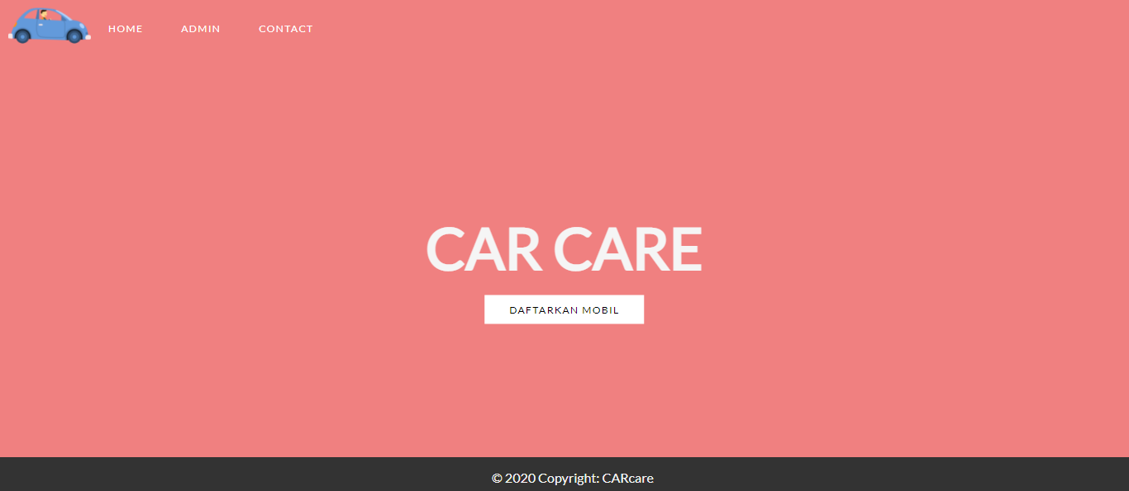
Home Page

Slide 5
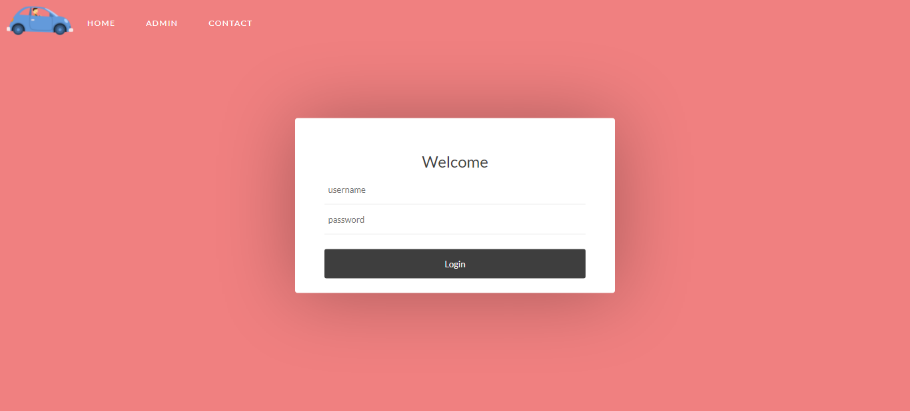
Login Page

Slide 6
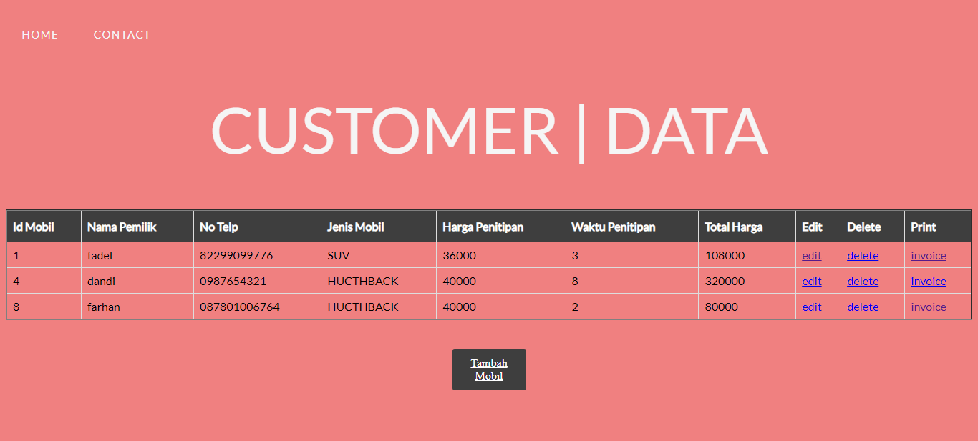
Customer Data

Slide 7
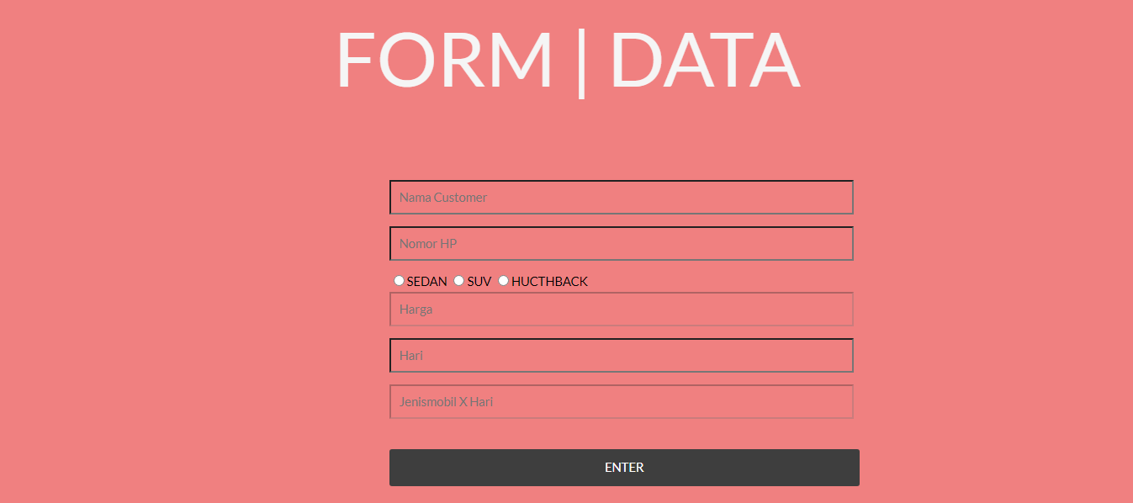
Tambah Mobil

Slide 8
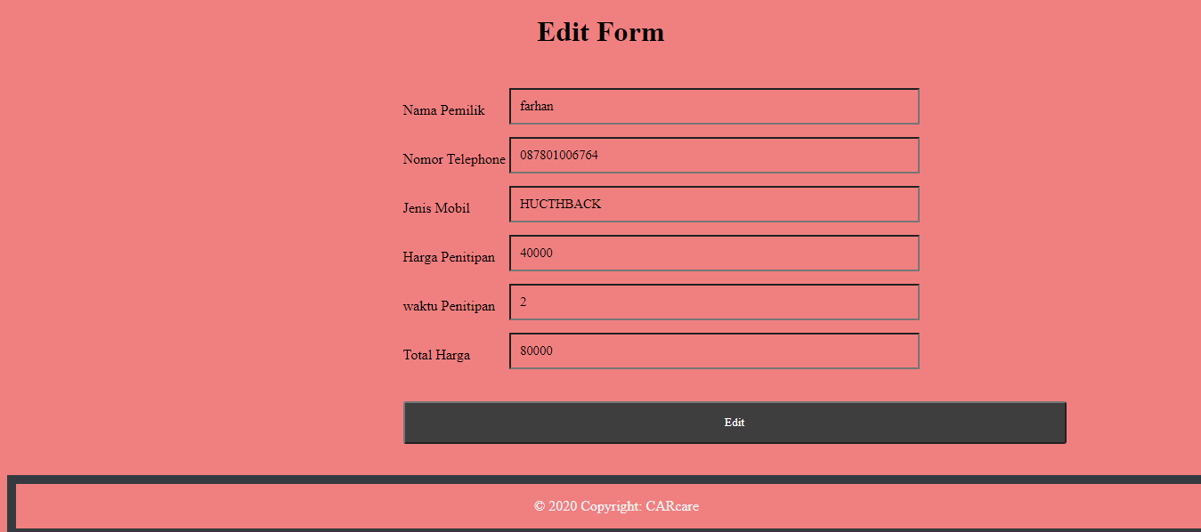
Edit View

Slide 9
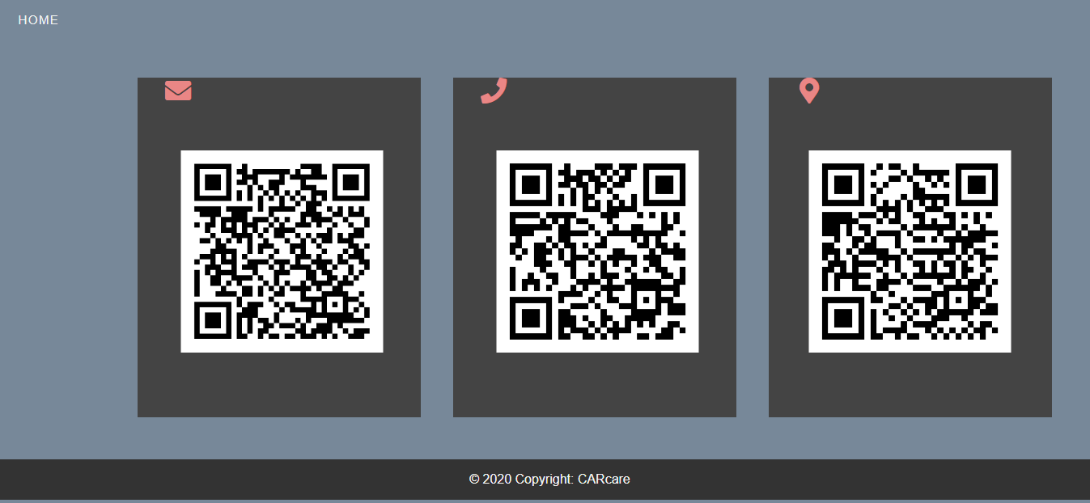
Contact

Slide 10
Thankyou
CAR CARE

